Slide 1
ACSU - Automated Climate Sensory Unit

Slide 2
Group Members:-
SRI ABHISHEK MAMIDI- 19MIM10047
MOHITH SANKAR- 19MIM10098
BOMMISETTY KRISHNAH MAANAS- 19MIM10090
RAJ KAMAL PATEL- 19BCG10030
SIDDHU CHELLURU- 19BCY10178
GHADIYARAM HANUMANTH SREENIVAS DIXIT- 19MIM10037
SANJAY S- 19BCE10265
PANDIPATI PAVAN- 19BCE10245

Slide 3
Index:-
Introduction
Related work
Methodology
Novelty
Conclusion

Slide 4
Introduction
Global-warming is leading us towards climate catastrophe. There have been many instances where a greedy cause of cutting trees brought upon many calamities which are still a big scar to our humanity. It is alarming that many cities are lacking dense areas having trees. Owing to the fact, That the trees will emit the Oxygen and controls climate in the surrounding areas.
They are great at preventing the soil erosion and air pollution. As it becomes our responsibility to monitor the trees which are surrounding to us, Instead it is evident that trees are decreasing in major cities. As the tree monitoring can be tough for a mere human, It is necessary to make a surveillance system/monitoring system which can report the pollution index according to the density of trees in an area.
This can make the people aware about the disadvantages that are caused by lack of trees.

Slide 5
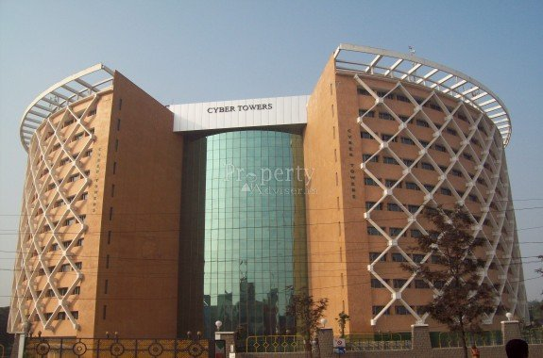
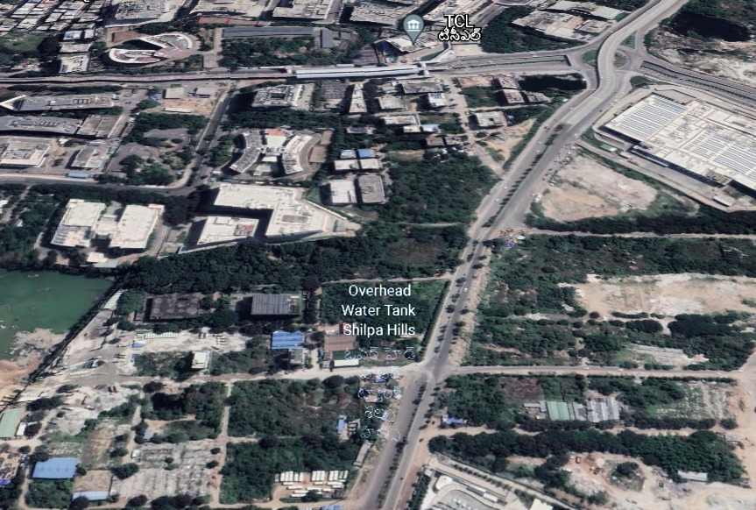
Case 1

Slide 6
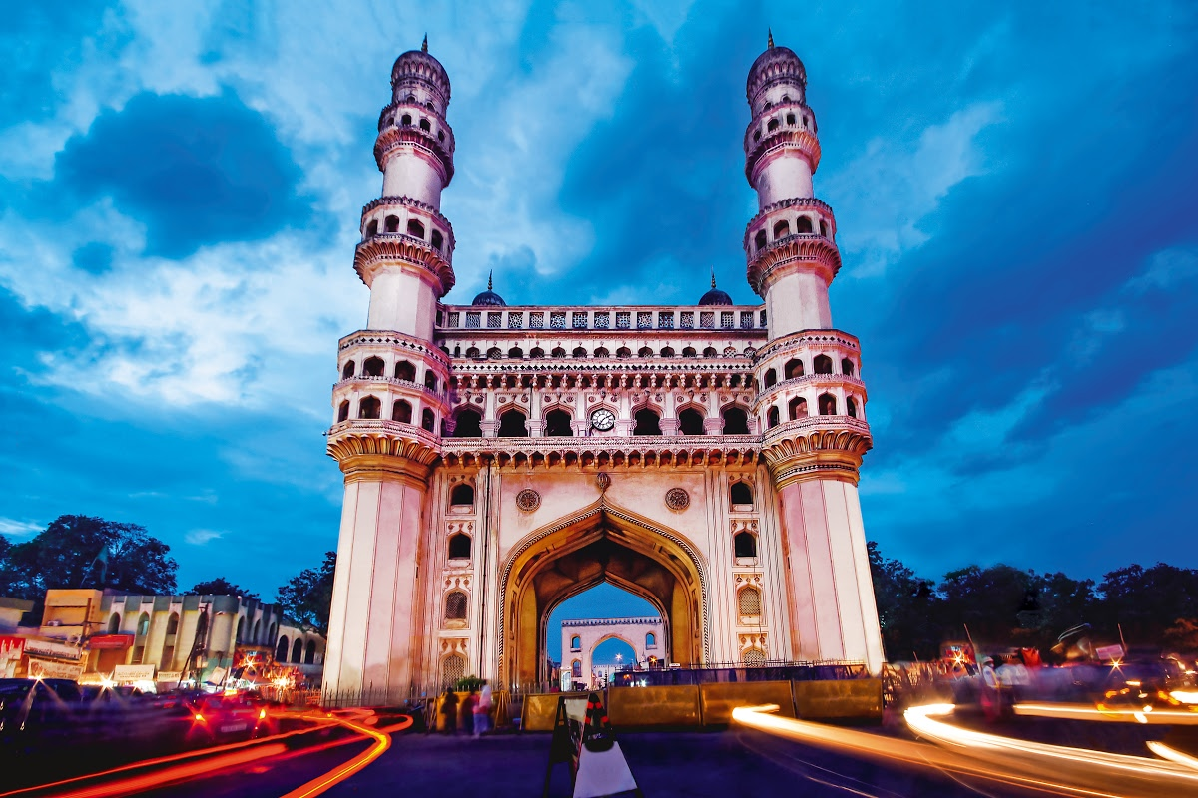
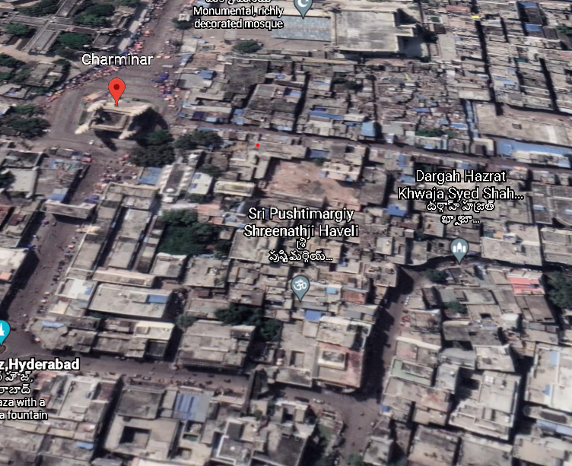
Case 2

Slide 7
To preserve the vitality of the trees and thus, the previously mentioned benefits, continuous monitoring and maintenance of the urban tree population is inevitable

Slide 8
Objective
Keeping the disadvantages of the above situation in mind, It is very important to preserve trees and monitoring is one of the most effective measures which can be implemented at a large scale. Which will be like why we are aiming to build a tree monitoring application using deep learning and google maps.

Slide 9
Methodology:
The purpose of this thesis is to investigate a system that can automatically predict the health condition of individual trees from street-level imagery.
This task is approached by training deep convolutional neural networks (CNNs) using automatically generated ground truth data.
This section first describes the generation of the required ground truth image data by combining available tree inventories with images from Google street-view.
Second, the chosen CNN architecture based on the VGG-16 (Simonyan and Zisserman, 2014) is presented.

Slide 10
Objective of the project is to detect the air quality index at a given area on the basis of geographical references taken from google maps and deep learning (CNN).
We are going to extract the image patches i.e, We will take the non clear and irregular images or pics of the trees from the Google street views.
There are some sequential order of operations which are going to be done or performed as a part in this project.
They will be given as follows:

Slide 11
Steps or Process involved
Extracting image patches from Google street-view panoramas
For each ground truth tree location with a given annotation date, a corresponding street-level image was downloaded from Google street-view by carrying out the following sequence of operations.

Slide 12
1. Crawling metadata of the nearest seed panorama.
2. Crawling metadata of linked panoramas.
3. Filtering linked panoramas by distance.
4. Selecting the panorama of interest.
5. Downloading the image data.
6. Extracting image patch at tree location.
7. Assigning image label from tree inventory annotations.

Slide 13
Novelty of the Project
The lack of practical and working models in India had made us to think in such a way that we need to make a monitoring system to check upon the trees and air pollution at a given area and we are interested to implement it in a large-scale.

Slide 14
Conclusion
By the time we are presenting the first review of this project, we got to know about the concept and the objective of the project and gathered all the necessary information required to understand the project.
In the process of building the model, we got introduced with the required tools which are needed to build the model.
We got a clear vision about the upcoming steps we need to execute.

Slide 15
THANK YOU

